Slide 1
Transparent First-class Futures and
Distributed Components
Antonio Cansado, Ludovic Henrio, Eric Madelaine
Introduction: components, futures, and challenges
Statically Representing Futures
An Example
Extension and Conclusion

Slide 2
INTRODUCTION: COMPONENTS, FUTURES, AND CHALLENGES

Slide 3
GCM Components
CI.foo(p)
Primitive components communicating by asynchronous remote method invocations on interfaces (requests)
Components abstract away distribution and Concurrency
in ProActive components are mono-threaded
➔ simplifies concurrency but can create deadlocks

Slide 4
Composition
requests

Slide 5
Futures for Components
f=CI.foo(p)
CI.foo(f)
CI.foo(f)

Slide 6
First-class Futures
…
…
…
f=CI.foo(p)
CI.foo(f)
Only strict operations are blocking (access to a future)
Communicating a future is not a strict operation

Slide 7
First-class Futures
…
…
…
f=CI.foo(p)
CI.foo(f)
Only strict operations are blocking (access to a future)
Communicating a future is not a strict operation

Slide 8
Future Update Strategies
In ASP / ProActive, the result is insensitive to the order of replies

Slide 9
Challenges Related to Component and Futures
Objective: build a behavioural model for components using transparent first-class futures.
➔ Detect dead-locks, reachability, …
Requirements/Challenges:
A static representation for futures
A static approximation of the flow of futures

Slide 10
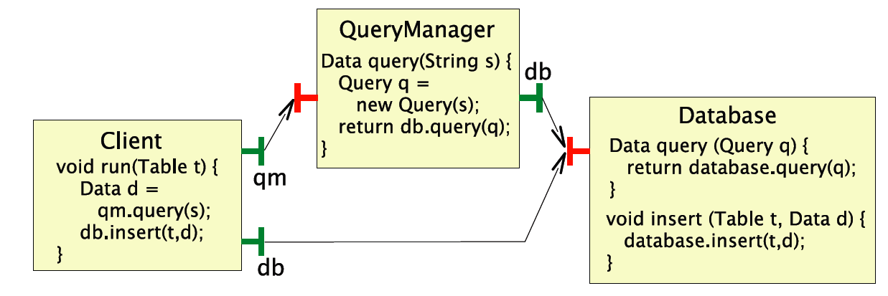
What is a Blocked Component?
A race condition:
A future f is non-blocking iff, under fairness hypothesis:
each time the action waitFor(f) is performed, the action getValue(f,val) is eventually reached.
A component is non-blocking if all its futures are non-blocking

Slide 11
Components and Futures
Components abstract distribution
➔ Future creation points
But future flow still to be inferred
➔ component specification language (e.g. JDC)
Futures create transparent channels that do not directly follow bindings
Components provide interface definition which can be complemented with future flow information

Slide 12
A STATIC REPRESENTATION FOR FUTURES

Slide 13
An Abstract Domain for Futures
fut(a) represent an abstract value that can be a future,
Lattice of abstract values:
if a ≺ b, then a ≺′ b, a ≺′ fut(b), and fut(a) ≺′ fut(b)
f=itf.foo(); // creation of a future
if (bool)
f.bar1(); // wait-by-necessity if bool is true
➔f.bar2(); // wait-by-necessity if bool is false

Slide 14
A Basic Future Proxy
?call
?response(val)
Remote
component
(invoked)
Caller
component
(local)
!getValue(val)
This proxy is not sufficient:
The caller could be used to transmit future values
BUT this would create an additional synchronisation and dead-locks (non First-class futures)

Slide 15
To Forward Futures as Request Parameters
f=CI1.foo(p)
void foo(Object p) {
…
CI.bar(p)
CI2.foo(f)

Slide 16
To Forward Futures as Request Parameters
?forward(val)
?call
?response(val)
!forward(val)
!forward(val)
!getValue(val)
!getValue(val)
?forward(val)
Add a !forward on the sender side, before !getValue
Create a receiver proxy on the receiver side with ?forward instead of ?call and ?response
The potential future flow must be known
!getValue(val)

Slide 17
To Forward a Future as Request Result
void foo(Object p) {
f=CI.bar(p)
return f;
f’=CI.foo(p);

Slide 18
To Forward a Future as Request Result
f.response(val)
?call
?response(val)
?forward(val)
f’
f’.forward(val)
!forward(val)
!f’.getValue(val)
Replace !getValue by !forward on the sender side
Create a receiver proxy
somehow f=f’
The future flow must be known

Slide 19
Future Update Strategies and Behavioural Specification
Our behavioural proxy implements a forward-based strategy
responses follow the flow of future references,
Like in ProActive,
We proved that all strategies are equivalent,
Behaviour is compositional, provided the future flow is given.
What kind of proxy to use? Sometimes use several proxies and choose when composing behaviours.

Slide 20
An Alternative: Global Futures
!response(val)
?call
?response(val)
?call
?response(val)
Equivalent semantics (ASP),
Optimised, i.e. less interleaving,
But non compositional
!getValue(val)
!getValue(val)

Slide 21
AN EXAMPLE

Slide 22
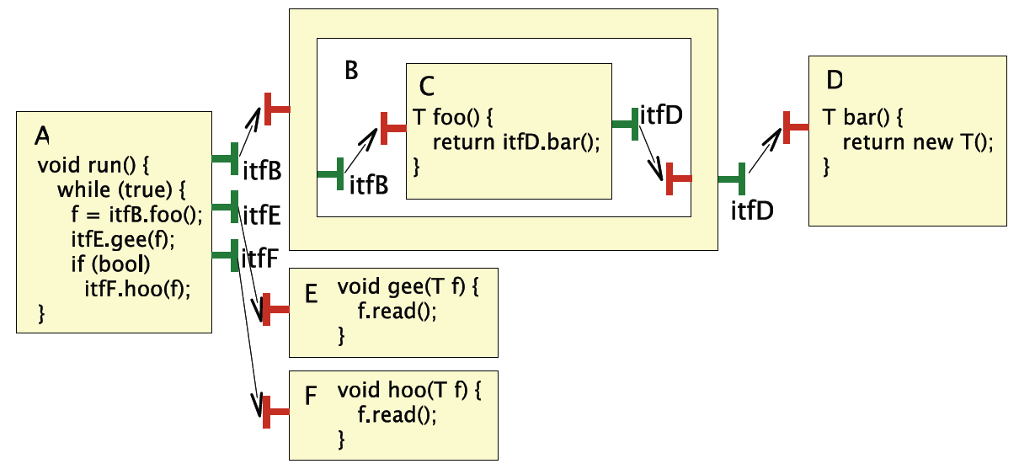
Component Architecture

Slide 23
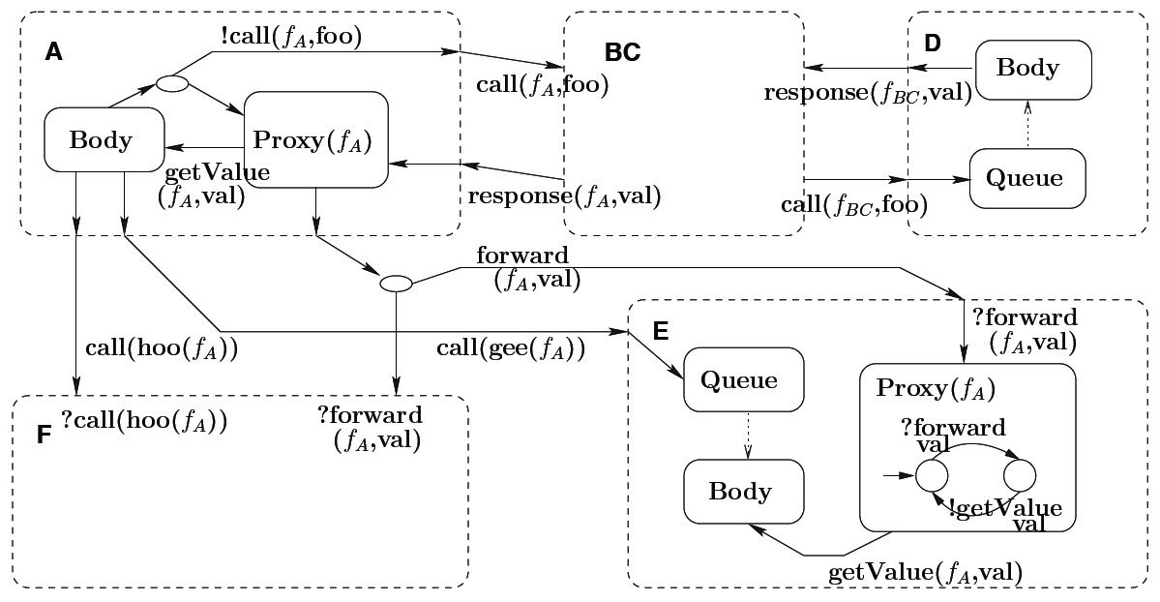
Behavioural Model

Slide 24
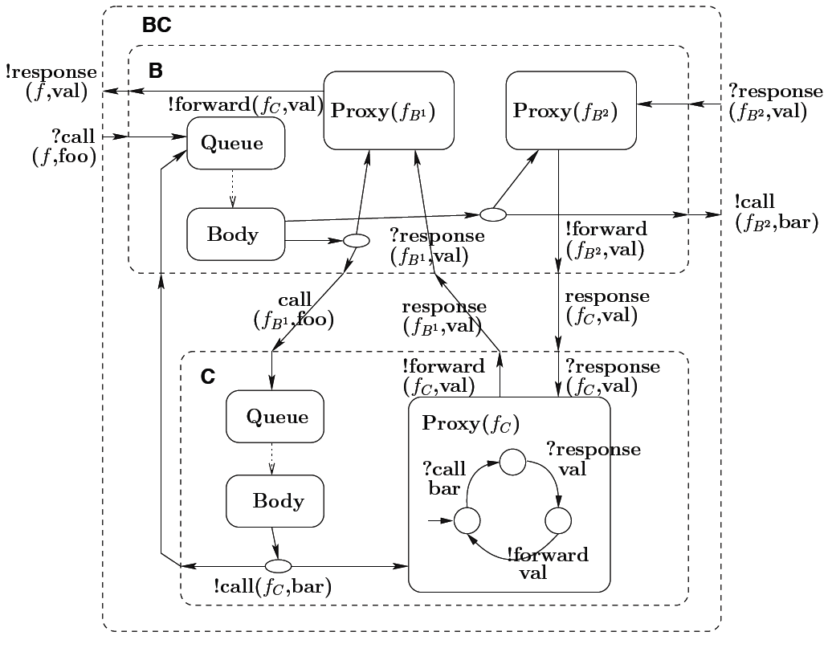
Details of Components B+C
In CADP toolbox:
12 labels, 575 states and 1451 transitions;
when minimised using branching bisimulation 52 states and 83 transitions

Slide 25
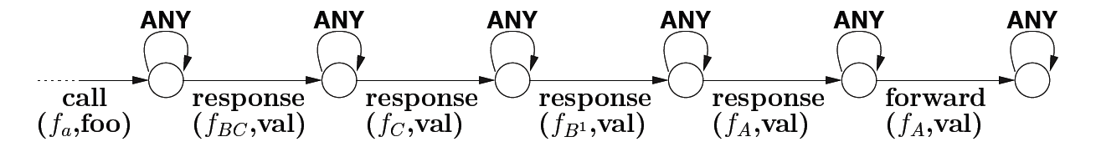
Properties
The system is deadlock free
All the futures are updated:
System deadlocks if the composite does not support first-class futures
System deadlocks if itfB.foo() is synchronous

Slide 26
EXTENSION AND CONCLUSION

Slide 27
Extending the Interface Definitions
To be safe, the behavioural model must consider as a future every variable that may be a future
Even more complex for objects and fields
Extend interface definition with strictness annotations: strict parameters do not need a proxy for future
To be ensured by the middleware at serialization:
before sending the value check that it is not a future
interface DB {
Data query(Query q);
void insert(Table t, @StrictValue Data d);
}

Slide 28
Conclusion
A generic model for futures
  New lattice of abstract values
  Proxy for future, with modifications for forwarding futures as request/response
  Applied to GCM components, but could be applied to other models (cf AmbientTalk, Creol, λfut)
  A strategy that guarantees that all futures are updated
To specify behaviours and prove properties, particularly deadlocks (cycle of wait-by-necessity on futures in GCM/ProActive)
Suggest an extension of interface definition language

